Slide 1
Why Your Dad’s database is not suitable for the Internet of Things
Joe Drumgoole
Director of Solutions Architecture (EMEA)
@jdrumgoole

Slide 2
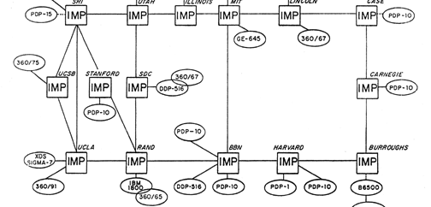
The Internet - 1971
Notes:
The ARPANET begins the year with 14 nodes in operation. BBN modifies and streamlines the IMP design so it can be moved to a less cumbersome platform than the DDP-516. BBN also develops a new platform, called a Terminal Interface Processor (TIP) which is capable of supporting input from multiple hosts or terminals.
The Network Working Group completes the Telnet protocol and makes progress on the file transfer protocol (FTP) standard. At the end of the year, the ARPANET contains 19 nodes as planned.
Database lauched in 1970. This internet didn’t even have TCP/IP. Unix hadn’t been invented. IBM resisted Ted Codds innovation allowing Oracle to launch the worlds first SQL database.

Slide 3
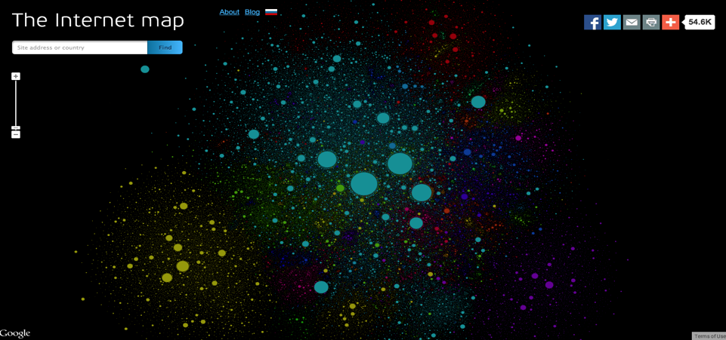
The Internet - 2014
Notes:
This is the internet today. Millons of nodes. All big server farms, giant distributors of data. This is the Internet of people. Nearly all of the data on this internet was created by humans for consumption by humans,

Slide 4
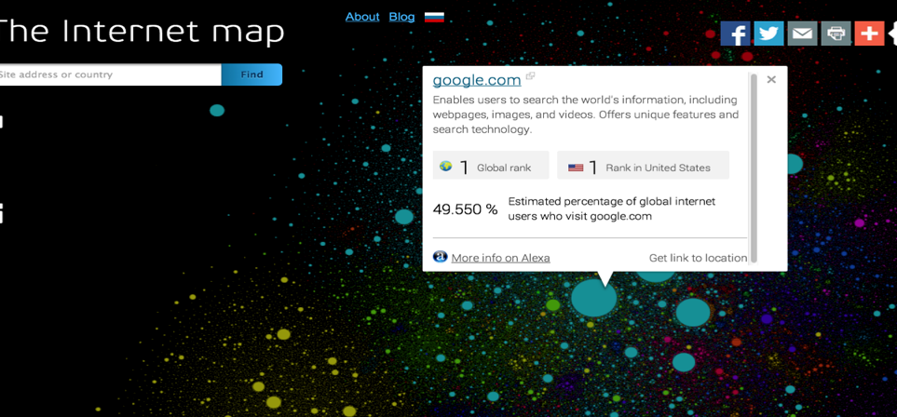
The Internet 2014
Notes:
Here is google. Its pretty big.

Slide 5
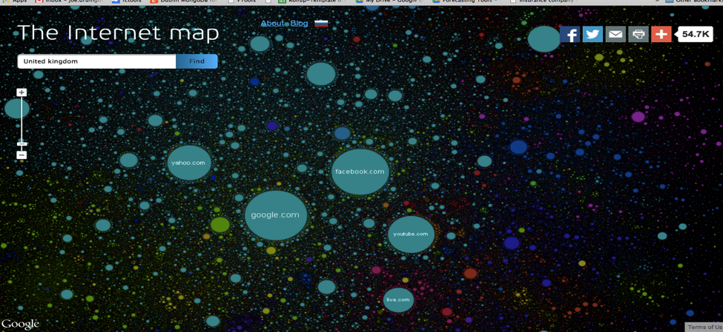
The United Kingdom on the Internet
The United Kingdom
Notes:
Here is the United Kingdom. Its pretty big, but it consists of a a collection of servers that are essentially “broadcast” nodes. I worked here in 1997-98 at Nomura a big investment bank. At the time I carried a pager but I still didn’t own a mobile phone. Nomura was engaged at the time in a strategic project to replacing its old mainframe technology with a network of Sun Servers. The huge internal debate at the time was whether we should or shouldn’t give internet access to staff. Would they “waste” all their time browsing the Internet.
And fundamentally the internet hasn’t changed much since that day.

Slide 6
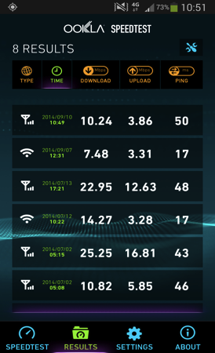
It’s Asymmetric
Notes:
Its still asynchronous. We read more than we write. Ajax and HTML4 have changed the way we interact with. Reflects the way the web was designed. Predominantly broadcast based. More readers than writers. More downloads than uploads. More clients than servers. There has been once big sea change since 1998. Mobile.

Slide 7
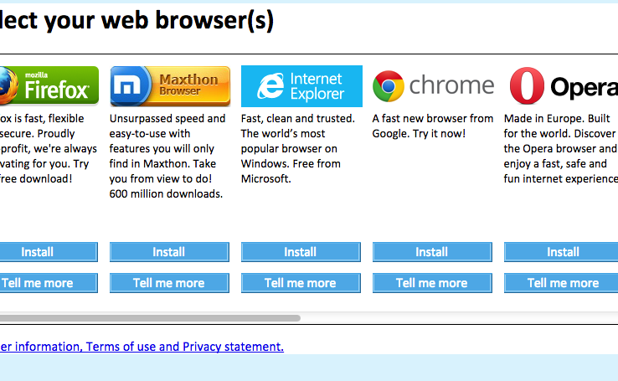
What used to be at the Edge?
Notes:
Input via, mouse, keybooard, voice, camera. Dumb consumption on both sides. It’s a desktop computer.

Slide 8
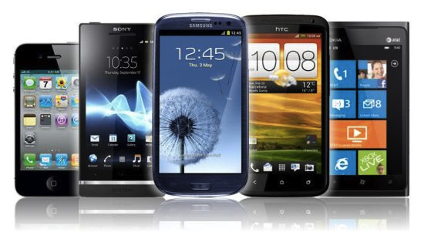
Today

Slide 9
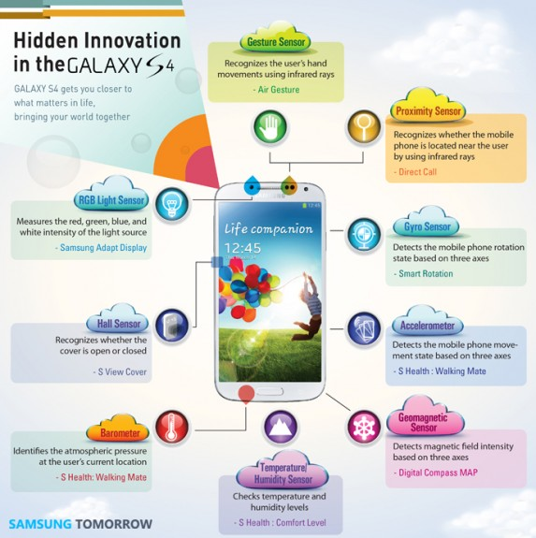
What’s Different
Notes:
9 hidden sensors + camera 10 + voice 11. Intrinsic connection to the Internet. Constantly capturing context.

Slide 10
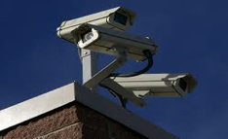
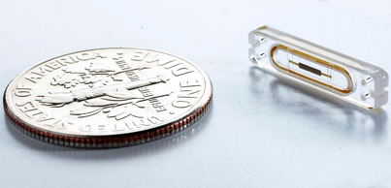
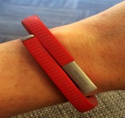
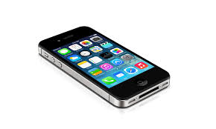
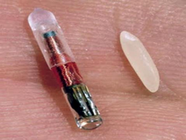
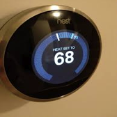
It’s a sensor world
Notes:
It’s a sensor world.

Slide 11
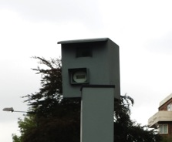
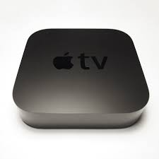
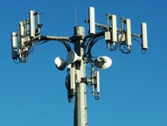
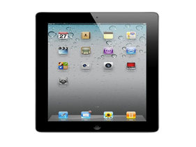
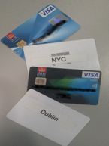
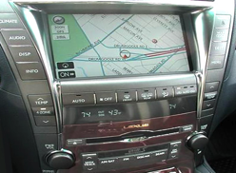
Everyday Sensors
Notes:
Super dense network. System Steps. High resolution video. What I watch. Where I go what I buy, when I arrive and leave work. Where I drive. What I eat. What I play. What I browse. Inbound data. Feedback loops.

Slide 12
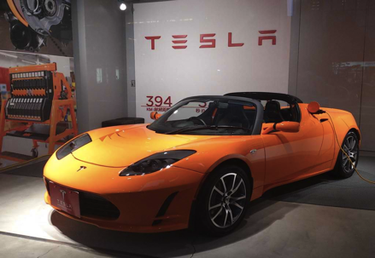
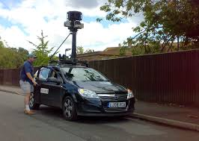
Exotic Sensors
Notes:
Sensor machines redefining our world. Tesla continues to improve mileage on their cars by aggregating car data. Streetview cars have changed our view of the world.

Slide 13
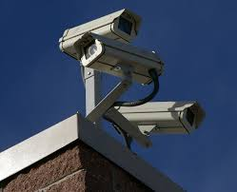
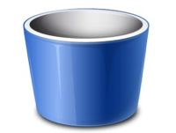
What used to Happen
Local
Database
Notes:
Protocols were analog or proprietary. No feedback loop. Data was often compressed. Usually discarded after lying idle and unused.

Slide 14
What Happens Today
The Internet
Cloud
Database
Notes:
We ain’t in Kansas anymore and that database is more often than not a NoSQL datanbase. Why ? Because the stream of data we capture from sensors is unstructured /semi structured and located in time and space.

Slide 15
What enables the IoT?
Ubiquitous, cheap sensors and controllers
Ubiquitous cheap bandwidth
HTTP/TCP/IP as a universal protocol
On demand storage at cents per GB
Notes:
Sparkfun, iBeacon. Arduino, Raspberry PI, MEMs. Frameworks. 1TB in 1980? 193m dollars.

Slide 16
Why Now?
What is the next big thing?
The thing we have been doing badly for the last ten years
Notes:
Mobile phones, smart phones, iPhone, Android. Analog cameras, digital cameras. Wais, Gopher archie to WWW. Dial uo to broadband. We reduce friction and people do something more.

Slide 17
IoT Demands
What When Where
Store-Filter-Distribute
Millions of events per minute
Future use cases
Notes:
Contextual, temporal,all the sensors on that phone related data to time and place. We store everything for ever. The data

Slide 18
Journey and Context
Arrival
Welcome / Greeting. Personal concierge (“whisk away”). Alert to staff member.
Find / Browse
Self-service on phone - “how can we help today?”. “Let us come to you”. Insertion point for relevant information, offer, or reminder. Here to pick something up? Timer for being dealt with. Partner brands?
1
2
4
Departure
Thanks. “by the way…”, RAOK.
3
Here for Action
Pick up. Queue jump. Get service with reduced friction, uncertainty.
Notes:
Here is a an example of a iBeacon retail application. This is from a startup based in ireland called LocalSocial. They do a retail engagement app. Now we can define how we want to interact with a shop, from “I’ll help my self “ to find my sizes. Finish with offers. Use high resolution location to tailor the experience. Works for real-estate as well.

Slide 19
Dad’s Database Assumptions
Expensive Storage
Cheap Programmers
Tables of strings, ints, floats, dates
One big machine
A small number of connected users
A well defined unchanging set of requirements
Fortran and Cobol as coin of the realm
These are IoT Anti-Patterns

Slide 20
MongoDB
JSON Document Model with Dynamic Schemas
Auto-Sharding for Horizontal Scalability
Text Search
Aggregation Framework and MapReduce
Hadoop Integration
Full, Flexible Index Support and Rich Queries
Built-In Replication for High Availability
Advanced Security
Large Media Storage with GridFS
GeoJSON Indexing

Slide 21
Thank You
Notes:
MongoDB – database designed for the Internet of today and tomorrow for unknown unknowns.

